Slide 1
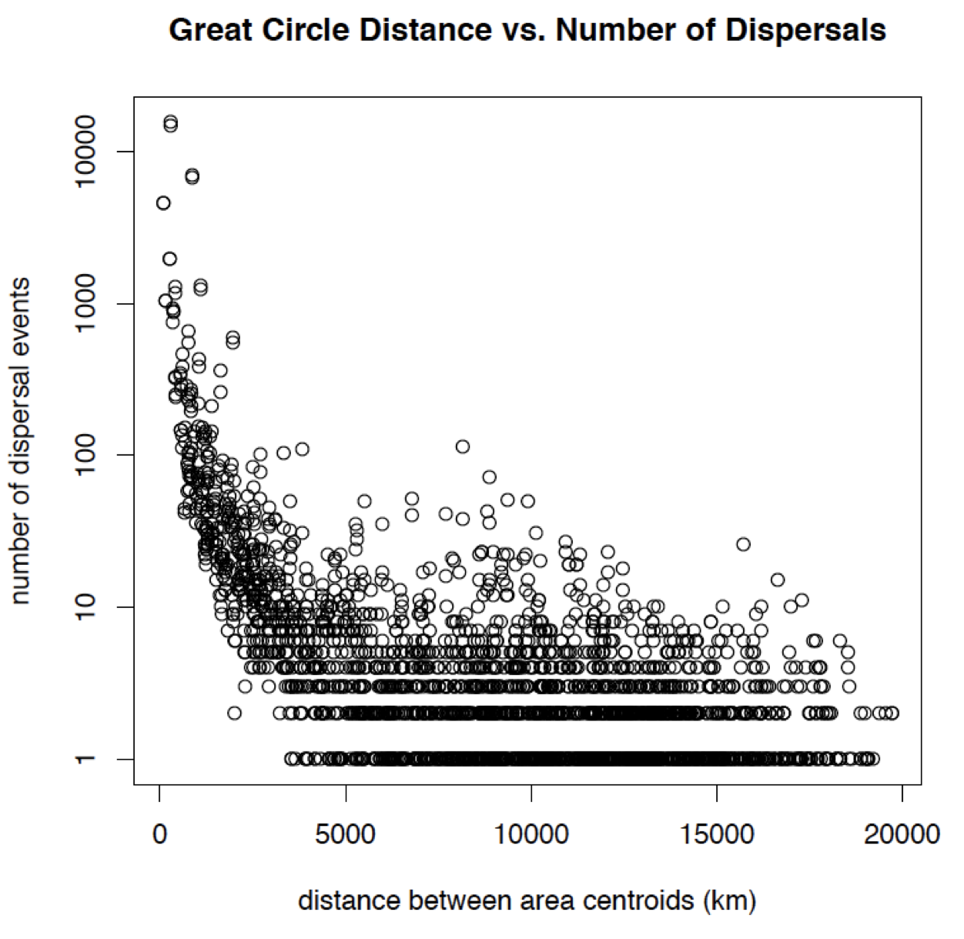
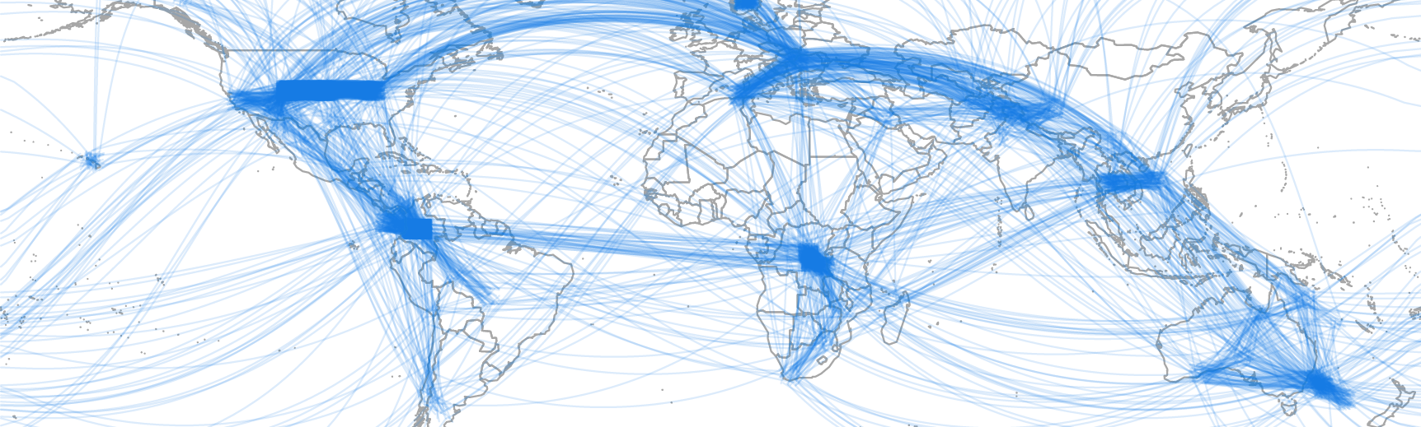
Macroevolutionary dispersal:
From miracle to mechanism in biogeography
Nicholas J. Matzke, Senior Lecturer, SBS, U. Auckland
Historical biogeography method:
Preliminary data (BioGeoBEARS)
(Phylogeny: 16,309 plant species,
173 billion years of branch length, from Zanne et al. 2013)
“Miracles”:
Long-distance dispersal (LDD)
# dispersal events
1 10 100 1,000 10,000
Garcia-R & Matzke (2021). J. Biogeography.
0 5,000 10,000 15,000 20,000
distance between biomes (km)
Bayesian Biogeographical Stochastic Mapping:
Core question: To what extent is “random,” “miraculous” long-distance dispersal actually statistically predictable, and thus understandable?
Notes:
173 billion years of branch length in this phylogeny

Slide 2

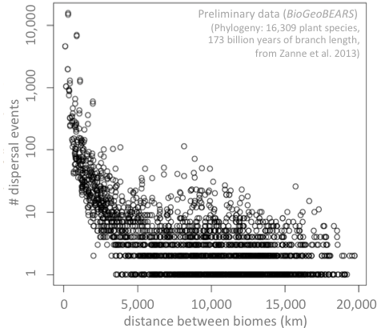
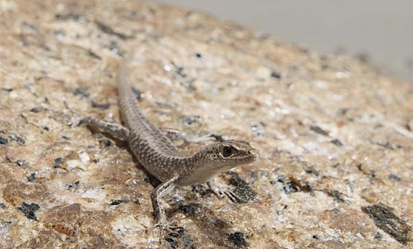
Long-Distance Dispersal: a core puzzle
Why are these “miracles” interesting?
JRSNZ Special issue call for papers: Evolutionary Biogeography of Aotearoa New Zealand
https://www.royalsociety.org.nz/news/jrsnz-special-issue-call-for-papers-evolutionary-biogeography-of-aotearoa-new-zealand
Is “luck” science? Can we “explain” anything
Computer models no different: they will happily infer “dispersal”
Alternatives:
Extinction:
Traits:
All species:
Living-only phylogeny:
A
A
F
A
A
F
C
D
E
B
…suggests many short dispersals
…suggests one long dispersal:
A
B
C
D
E
F
A
F
Notes:
173 billion years of branch length in this phylogeny

Slide 3
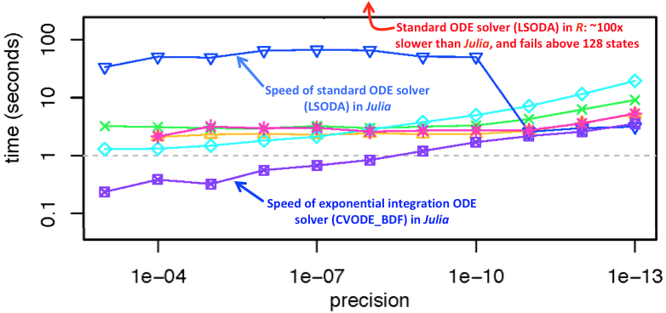
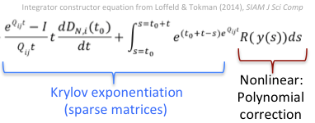

The challenge: Complex model speed
Main problem with including complexity: likelihood calculations are too slow!
Preliminary data: Julia speed ups
We have to integrate 2N differential equations for N biogeographic states:
…using exponential integrator technology:

Slide 4
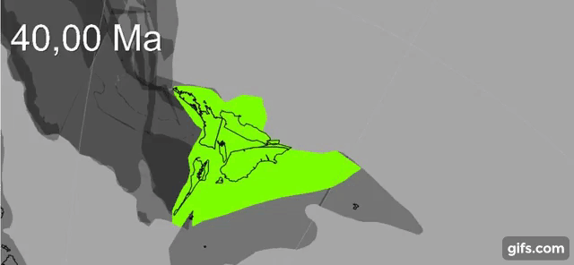
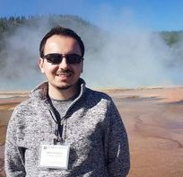
Comparison of model features
BioGeoJulia: complexifying biogeography
Integrate BioGeoJulia with GPlates for continuous palaeogeography
This Proposal (BioGeoJulia)
GPlates animation: Zealandia crustal thickness
Müller, Sahirovic et al. (2018), U. Sydney "Modelling and visualising distributed crustal deformation of Australia and Zealandia using GPlates 2.0." https://www.youtube.com/watch?v=iKkCIdZ6oaE
BioGeoJulia: extract & use continuous estimates of areas, distances
Sabin Zahirovic, GPlates coauthor, U. Sydney

Slide 5
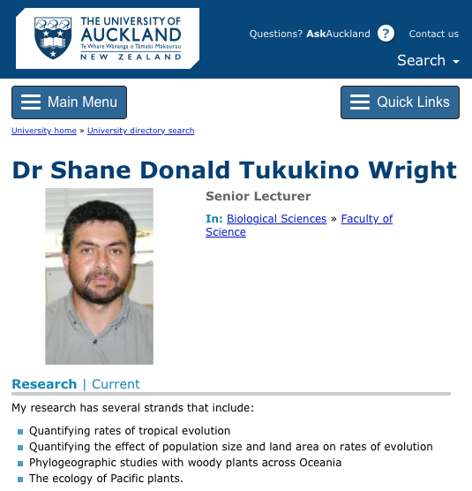
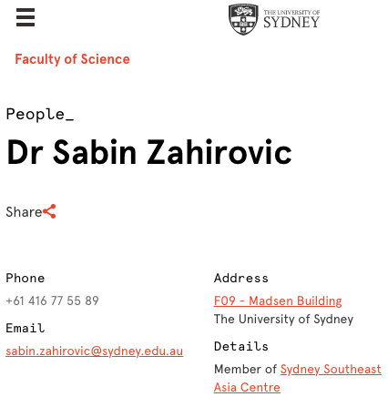

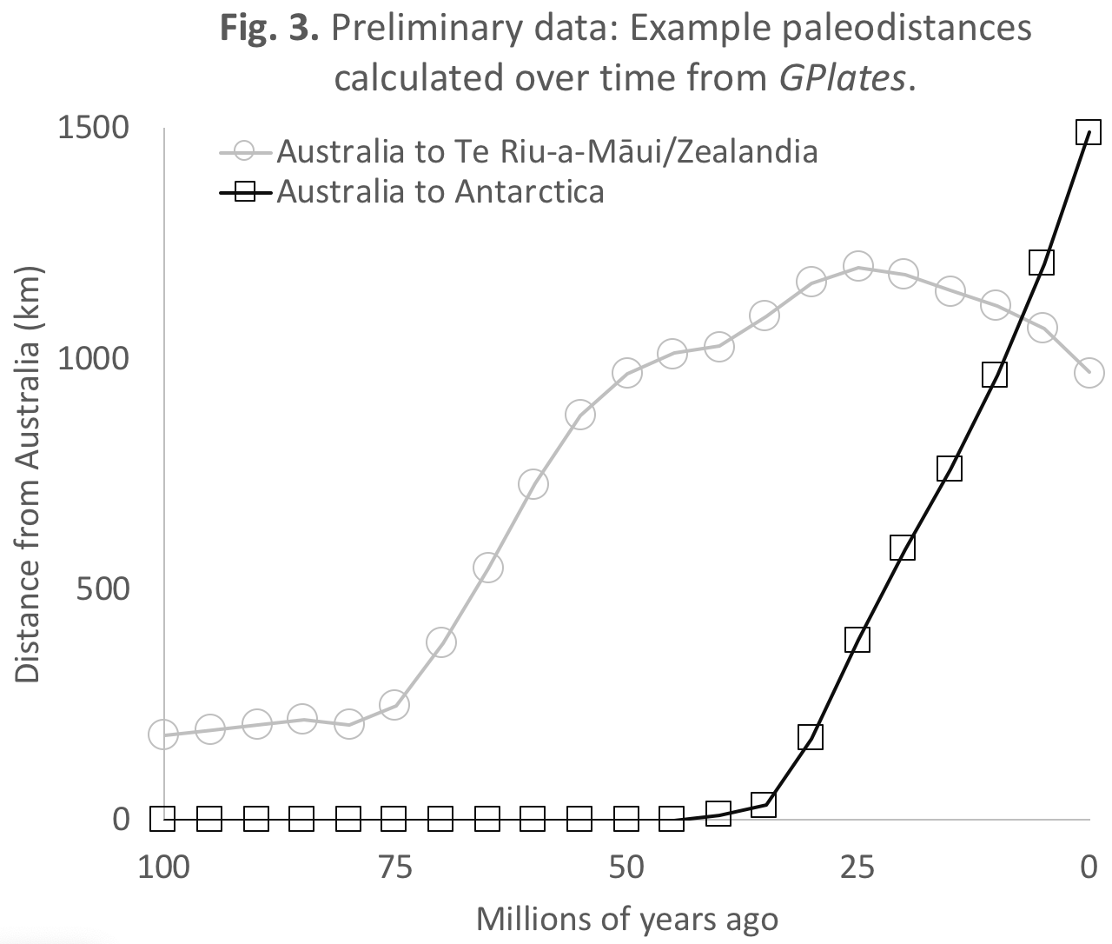

The Team
Expertise:
Pacific biogeography
Plant dispersal
Palaeoclimate of NZ and region
Indigenous names in taxonomy
Expertise:
Lead author of Gplates
Plate tectonics
Palaeogeography
Notes:
Shane is Te Ati HauNui-a-Paparangi, Whanganui region

Slide 6
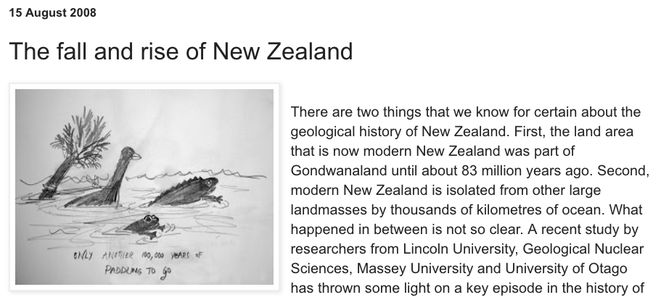

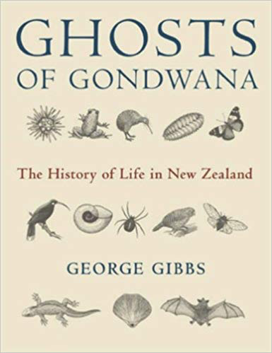
Conclusion: Benefits
Global leadership in phylogenetic biogeography, with a (new) “New Zealand School of Biogeography”
Better understanding the origins of NZ’s flora and fauna – and their fate, under anthropogenic disturbance
Further New Zealand’s leadership in open-source, entry-level computing with Julia (building on R)
Ebach (2018) on NZ in 1980s:

